Slide 1
Threads

Slide 2
Threads
Overview
Multithreading Models
Thread Libraries
Threading Issues
Operating System Examples
Windows XP Threads
Linux Threads

Slide 3
Objectives
To introduce the notion of a thread — a fundamental unit of CPU utilization that forms the basis of multithreaded computer systems
To discuss the APIs for the Pthreads, Win32, and Java thread libraries
To examine issues related to multithreaded programming

Slide 4
Motivation
Threads run within application
Multiple tasks with the application can be implemented by separate threads
Update display
Fetch data
Spell checking
Answer a network request
Process creation is heavy-weight while thread creation is light-weight
Can simplify code, increase efficiency
Kernels are generally multithreaded

Slide 5
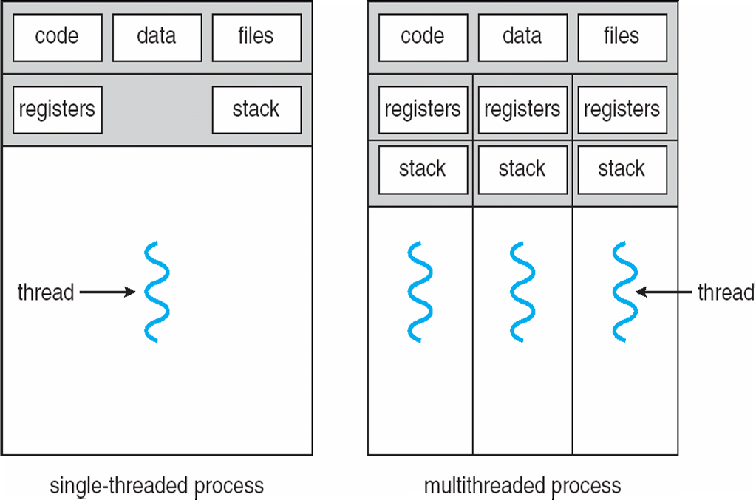
Single and Multithreaded Processes

Slide 6
Benefits
Responsiveness: Multithreading an interactive application may allow a program to continue running even if part of it is blocked or is performing a lengthy operation, thereby increasing responsiveness to the user.
Resource Sharing: The benefit of sharing code and data is that it allows an application to have several different threads of activity within the same address space.
Economy: Allocating memory and resources for process creation is costly. Because threads share the resources of the process to which they belong, it is more economical to create and context-switch threads.
Scalability: The benefits of multithreading can be even greater in a multiprocessor architecture, where threads may be running in parallel on different processing cores.

Slide 7
Multicore Programming
Multicore systems putting pressure on programmers, challenges include:
Dividing activities :This involves examining applications to find areas that can be divided into separate, concurrent tasks.
Balance : While identifying tasks that can run in parallel, programmers must also ensure that the tasks perform equal work of equal value.
Data splitting: Just as applications are divided into separate tasks, the data accessed and manipulated by the tasks must be divided to run on separate cores.
Data dependency : The data accessed by the tasks must be examined for dependencies between two or more tasks. When one task depends on data from another, programmers must ensure that the execution of the tasks is synchronized to accommodate the data dependency.
Testing and debugging: When a program is running in parallel on multiple cores, many different execution paths are possible. Testing and debugging such concurrent programs is inherently more difficult than testing and debugging single-threaded applications.

Slide 8
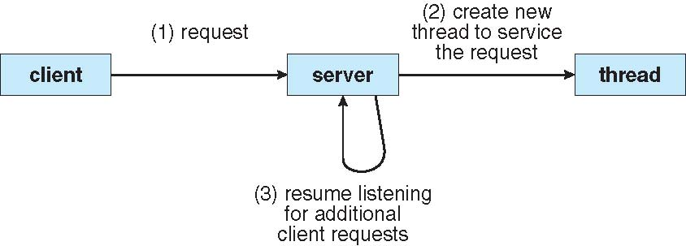
Multithreaded Server Architecture

Slide 9
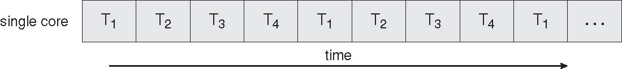
Concurrent Execution on a Single-core System

Slide 10
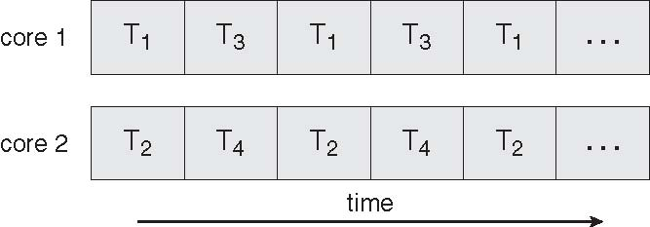
Parallel Execution on a Multicore System

Slide 11
User Threads
Thread management done by user-level threads library
Three primary thread libraries:
POSIX Pthreads
Win32 threads
Java threads

Slide 12
Kernel Threads
Supported by the Kernel
Examples
Windows XP/2000
Solaris
Linux
Tru64 UNIX
Mac OS X

Slide 13
Multithreading Models
Many-to-One
One-to-One
Many-to-Many

Slide 14
Many-to-One
Many user-level threads mapped to single kernel thread
Thread management is done by the thread library in user space.
However, the entire process will block if a thread makes a blocking system call.
Because only one thread can access the kernel at a time multiple threads are unable to run in parallel on multicore systems.
Examples:
Solaris Green Threads
GNU Portable Threads

Slide 15
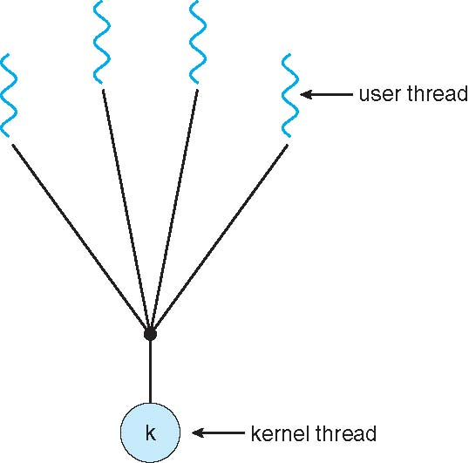
Many-to-One Model

Slide 16
One-to-One
Each user-level thread maps to kernel thread.
It provides more concurrency than the many-to-one model by allowing another thread to run when a thread makes a blocking system call.
It also allows multiple threads to run in parallel on multiprocessors.
The only drawback to this model is that creating a user thread requires creating the corresponding kernel thread.
Because the overhead of creating kernel threads can burden the performance of an application, most implementations of this model restrict the number of threads supported by the system.
Examples
Windows NT/XP/2000
Linux
Solaris 9 and later

Slide 17
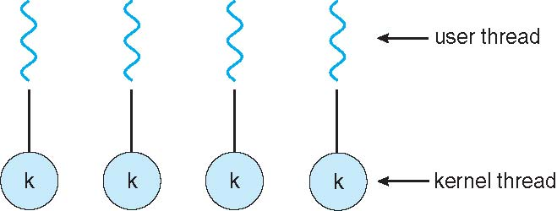
One-to-one Model

Slide 18
Many-to-Many Model
The many-to-many model multiplexes many user-level threads to a smaller or equal number of kernel threads.
Allows the operating system to create a sufficient number of kernel threads.
Solaris prior to version 9
Windows NT/2000 with the ThreadFiber package

Slide 19
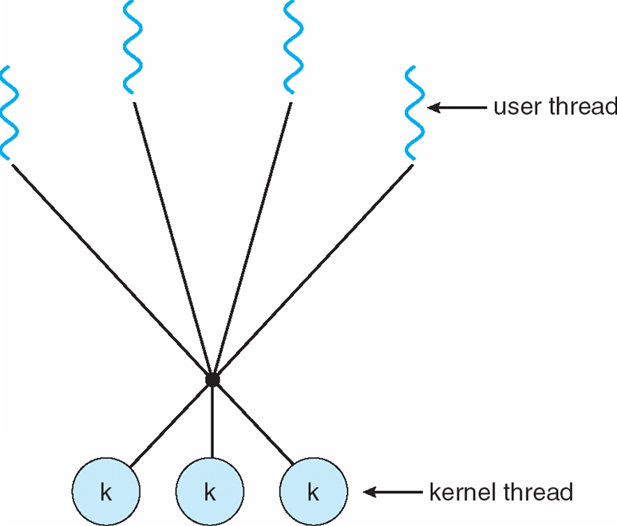
Many-to-Many Model

Slide 20
Two-level Model
Similar to M:M, except that it allows a user thread to be bound to kernel thread
Examples
IRIX
HP-UX
Tru64 UNIX
Solaris 8 and earlier

Slide 21
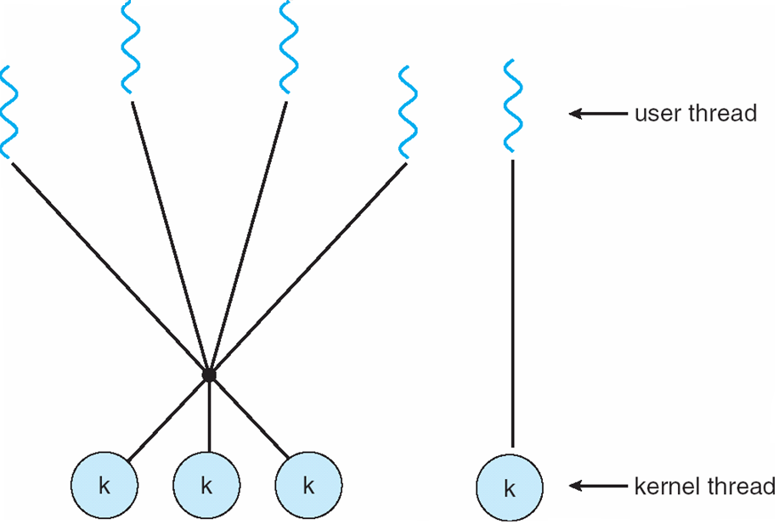
Two-level Model

Slide 22
Thread Libraries
Thread library provides programmer with API for creating and managing threads
Two primary ways of implementing
Library entirely in user space
Kernel-level library supported by the OS

Slide 23
Pthreads
May be provided either as user-level or kernel-level
A POSIX standard (IEEE 1003.1c) API for thread creation and synchronization
API specifies behavior of the thread library, implementation is up to development of the library
Common in UNIX operating systems (Solaris, Linux, Mac OS X)

Slide 24
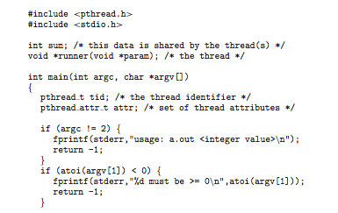
Pthreads Example

Slide 25
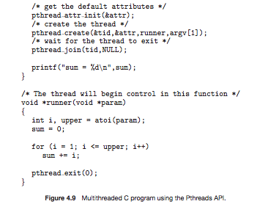
Pthreads Example (Cont.)

Slide 26
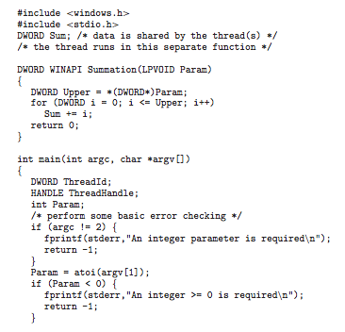
Win32 API Multithreaded C Program

Slide 27
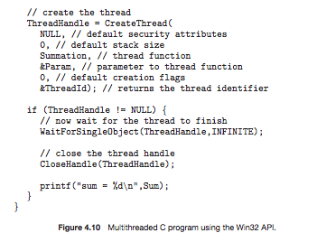
Win32 API Multithreaded C Program (Cont.)

Slide 28
Java Threads
Java threads are managed by the JVM
Typically implemented using the threads model provided by underlying OS
Java threads may be created by:
Extending Thread class
Implementing the Runnable interface

Slide 29
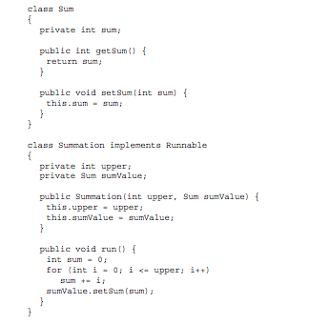
Java Multithreaded Program

Slide 30
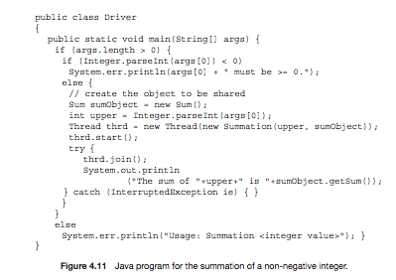
Java Multithreaded Program (Cont.)

Slide 31
Threading Issues
Semantics of fork() and exec() system calls
Thread cancellation of target thread
Asynchronous or deferred
Signal handling
Synchronous and asynchronous

Slide 32
Threading Issues (Cont.)
Thread pools
Thread-specific data
Create Facility needed for data private to thread
Scheduler activations

Slide 33
Semantics of fork() and exec()
If one thread on a program calls fork() , does the new process duplicate all threads , or is the new process single-threaded ?
Some UNIX systems have chosen to have two versions of fork(),
(a) one that duplicates all threads.
(b) one that duplicates only the thread that invoked the fork() system call.
Which of the two versions of fork() to use depends on the exec() system call.

Slide 34
Thread Cancellation
Terminating a thread before it has finished
Two general approaches:
Asynchronous cancellation terminates the target thread immediately.
Deferred cancellation allows the target thread to periodically check if it should be cancelled.

Slide 35
Signal Handling
Signals are used in UNIX systems to notify a process that a particular event has occurred.
A signal handler is used to process signals
Signal is generated by particular event
Signal is delivered to a process
Signal is handled
Options:
Deliver the signal to the thread to which the signal applies
Deliver the signal to every thread in the process
Deliver the signal to certain threads in the process
Assign a specific thread to receive all signals for the process

Slide 36
Thread Pools
Create a number of threads in a pool where they await work
Advantages:
Usually slightly faster to service a request with an existing thread than create a new thread
Allows the number of threads in the application(s) to be bound to the size of the pool

Slide 37
Thread Specific Data
Allows each thread to have its own copy of data
Useful when you do not have control over the thread creation process (i.e., when using a thread pool)

Slide 38
Scheduler Activations
Both M:M and Two-level models require communication to maintain the appropriate number of kernel threads allocated to the application
Scheduler activations provide upcalls - a communication mechanism from the kernel to the thread library
This communication allows an application to maintain the correct number kernel threads

Slide 39
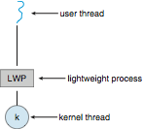
Lightweight Processes

Slide 40
Operating System Examples
Windows XP Threads
Linux Thread
Notes:
40

Slide 41
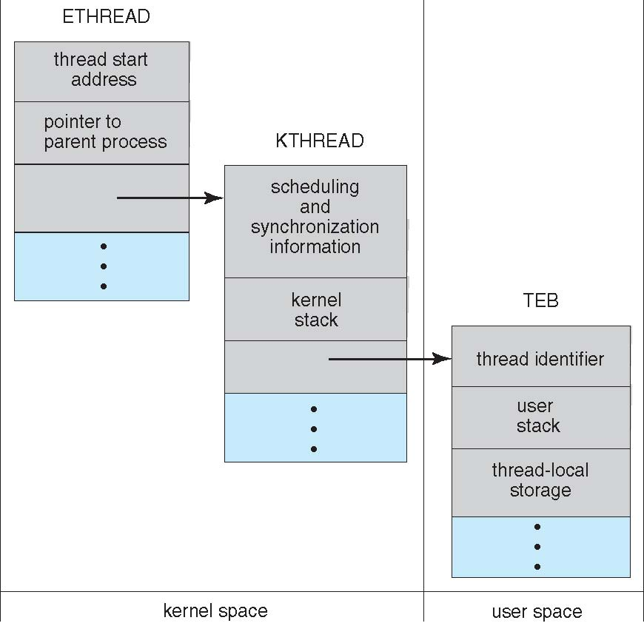
Windows XP Threads Data Structures

Slide 42
Windows XP Threads
Implements the one-to-one mapping, kernel-level
Each thread contains
A thread id
Register set
Separate user and kernel stacks
Private data storage area
The register set, stacks, and private storage area are known as the context of the threads
The primary data structures of a thread include:
ETHREAD (executive thread block)
KTHREAD (kernel thread block)
TEB (thread environment block)

Slide 43
Linux Threads
Linux refers to them as tasks rather than threads
Thread creation is done through clone() system call
clone() allows a child task to share the address space of the parent task (process)
struct task_struct points to process data structures (shared or unique)

Slide 44
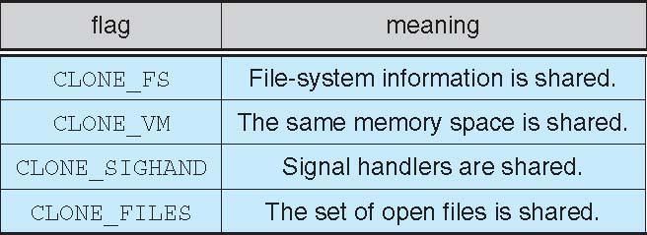
Linux Threads
fork() and clone() system calls
Doesn’t distinguish between process and thread
Uses term task rather than thread
clone() takes options to determine sharing on process create
struct task_struct points to process data structures (shared or unique)

Slide 45
End of Chapter 4

